Slide 1
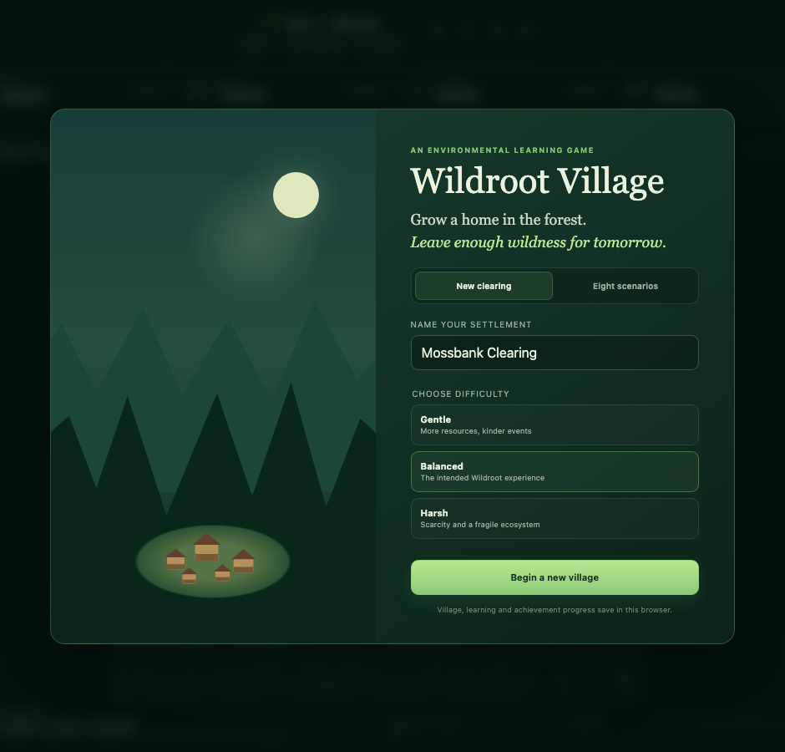
ECOSYSTEM VILLAGE PROJECT
Wildroot Village
An ecosystem-management and environmental learning game
Grow a home in the forest. Leave enough wildness for tomorrow.
BUILD
SIMULATE
LEARN
≈ 3-MINUTE PRESENTATION
CREATED BY
James · age 13
OPENING SCREEN
PRESENTED BY
Daniel Bryar

Slide 2
CREATOR STORY · JAMES, AGE 13
02
Why I created Wildroot Village
An idea inspired by climate change, global warming and the power of environmental education.
JAMES · CREATOR · AGE 13
PRESENTED BY · DANIEL BRYAR
ONE SIMPLE BUILDING CAN CHANGE A WHOLE SYSTEM
“Yesterday, thinking about climate change and global warming gave me an idea: a game that helps kids see how every building choice can change the environment.”
HABITAT
→
←
WATER
clear it or protect it
consume, capture or pollute
AIR + NOISE
→
←
SOIL
I want children to learn by making decisions and watching the results—not only by reading facts. Learning is integrated into the game through the Eco Coach, field missions, knowledge checks, inspections and scenarios.
create emissions or disturbance
compact, erode or restore
A SIMPLE BUILDING
↑
Create a thriving village with a healthy ecosystem.
PEOPLE
OVERALL GOAL
change jobs, health and learning
LEARNING IS INTEGRATED INTO PLAY
Eco Coach · field missions · knowledge checks · building inspections · environmental scenarios
CREATED BY JAMES, AGE 13 · PRESENTED BY DANIEL BRYAR
2

Slide 3
CORE GAME LOOP
03
The idea: prosper without breaking the system
Every expansion solves one problem while creating new pressure somewhere else.
01
PLAN
02
BUILD
03
MONITOR
04
ADAPT
→
→
→
Read the map, storage, population and weakest ecosystem indicator.
Place homes, services, workplaces and nature-based solutions.
Watch 24-hour resource trends, staff, noise, pollution and weather.
Change layout, jobs, reserves and restoration before a threshold is crossed.
THE GOAL
THE MAIN TENSION
THE FAILURE RULE
Grow a functioning village
Short-term output vs. long-term resilience
A weak link can collapse the settlement
Balance population, food, water, timber, stone, health, morale and education—without sacrificing the forest.
Industry can speed construction, but resource use, habitat loss, pollution and noise can weaken future production.
The village is lost below 5% overall ecosystem health, or immediately when any one of the six indicators reaches 0%.
100 × 100
3 minutes
1× / 2× / 3×
Freeplay + 8
Local
forest world
per day at 1×
true simulation speed
challenge scenarios
browser save
WILDROOT VILLAGE · ECOSYSTEM VILLAGE PROJECT
3

Slide 4
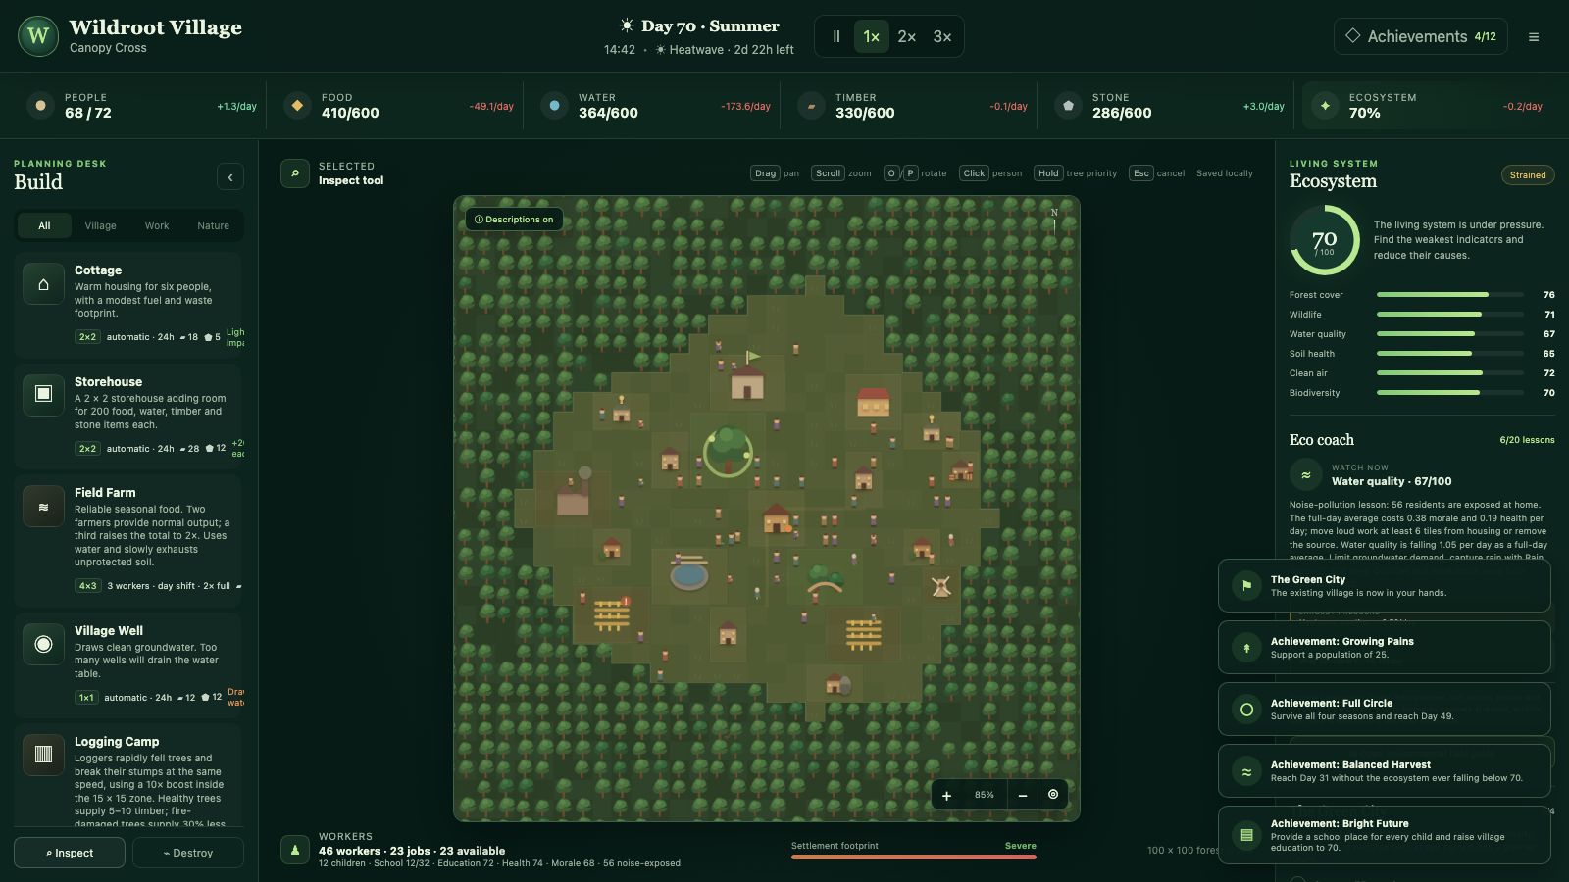
INTERFACE TOUR
04
How the player controls the village
The screen keeps construction, simulation evidence and environmental feedback visible at the same time.
1
1
Resources + time
Population, stored materials, /day trends, season, weather and speed controls.
2
Planning desk
2
4
Choose Village, Work or Nature buildings; then Inspect or Destroy.
3
3
Living map
Drag and zoom across the 100 × 100 forest; place only on free clearing tiles.
4
Ecosystem + Eco Coach
Six indicators, overall score, weakest trend, major pressure and best support.
5
Workforce + footprint
Jobs, available workers, children, schooling, health, morale and settlement pressure.
5
DRAG pan · SCROLL zoom · O/P rotate
SPACE pause · ESC cancel · HOLD tree priority
WILDROOT VILLAGE · ECOSYSTEM VILLAGE PROJECT
4

Slide 5
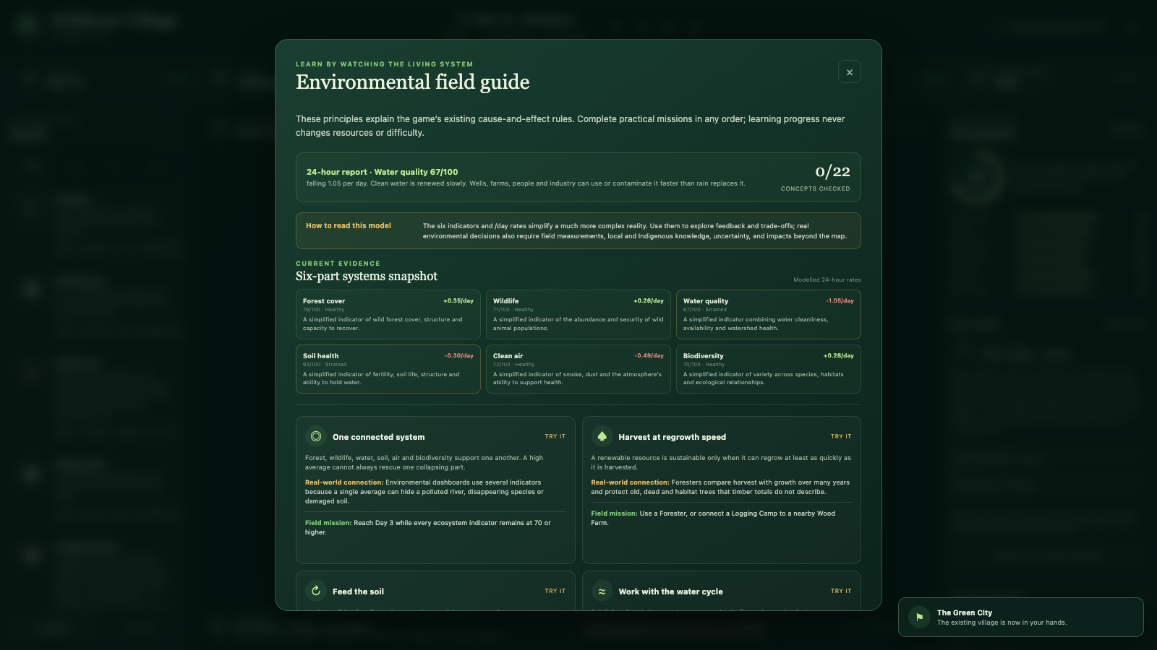
ECOSYSTEM SIMULATION
05
A living model, not a single score
Six connected indicators reveal weak links that an average could otherwise hide.
THE SIX INDICATORS
Forest cover
76
Wildlife
71
Habitat, carbon and recovery capacity
Abundance and security of animal populations
Water quality
67
Soil health
65
Cleanliness, supply and watershed health
Fertility, soil life and structural stability
Clean air
72
Biodiversity
70
Smoke, dust and atmospheric capacity
Species, habitats and ecological relationships
LIVE 24-HOUR FIELD GUIDE
CAUSE AND EFFECT
BUILDINGS + PEOPLE
WEATHER + SEASONS
24-HOUR RATES
FEEDBACK
use resources; create output, noise and pollution
→
change demand, production, fires, floods and growth
→
combine daytime staffing with overnight processes
→
changes food, health, morale and long-term resilience
COLLAPSE: <5% OR ANY 0%
WILDROOT VILLAGE · ECOSYSTEM VILLAGE PROJECT
5

Slide 6
VILLAGE SYSTEMS
06
People, work and the resource economy
Residents have homes, ages, jobs and journeys; buildings operate on different schedules and capacities.
PEOPLE + LIFE
Freeplay starts with 10 adult founders. The population includes children, adults and elders. Children become adults after 7 in-game days; residents have persistent homes and a hidden natural lifespan of 40–60 days.
WORK + MOVEMENT
Staffed buildings operate 07:00–18:30. Residents walk between home, work, parks, school and storage; workers carry 1–3 items per supply trip. Automatic buildings continue overnight.
STORAGE + SUPPLY
The Founders’ Hearth stores 400 of each material. Every Storehouse adds 200 food, water, timber and stone capacity. Production above the cap is discarded, so overnight reserves matter.
A WORKING VILLAGE
THREE IMPORTANT TRADE-OFFS
FARMS
FORESTRY
SITING
1 farmer = 0.5×; 2 = 1×; 3 = 2× output—and 2× water use and pressure.
Logging is fast nearby; Wood Farms regrow 16 plots in 5 days. Full storage pauses cutting.
Industry near crops reduces yield; loud buildings near occupied homes lower morale and health.
WILDROOT VILLAGE · ECOSYSTEM VILLAGE PROJECT
6

Slide 7
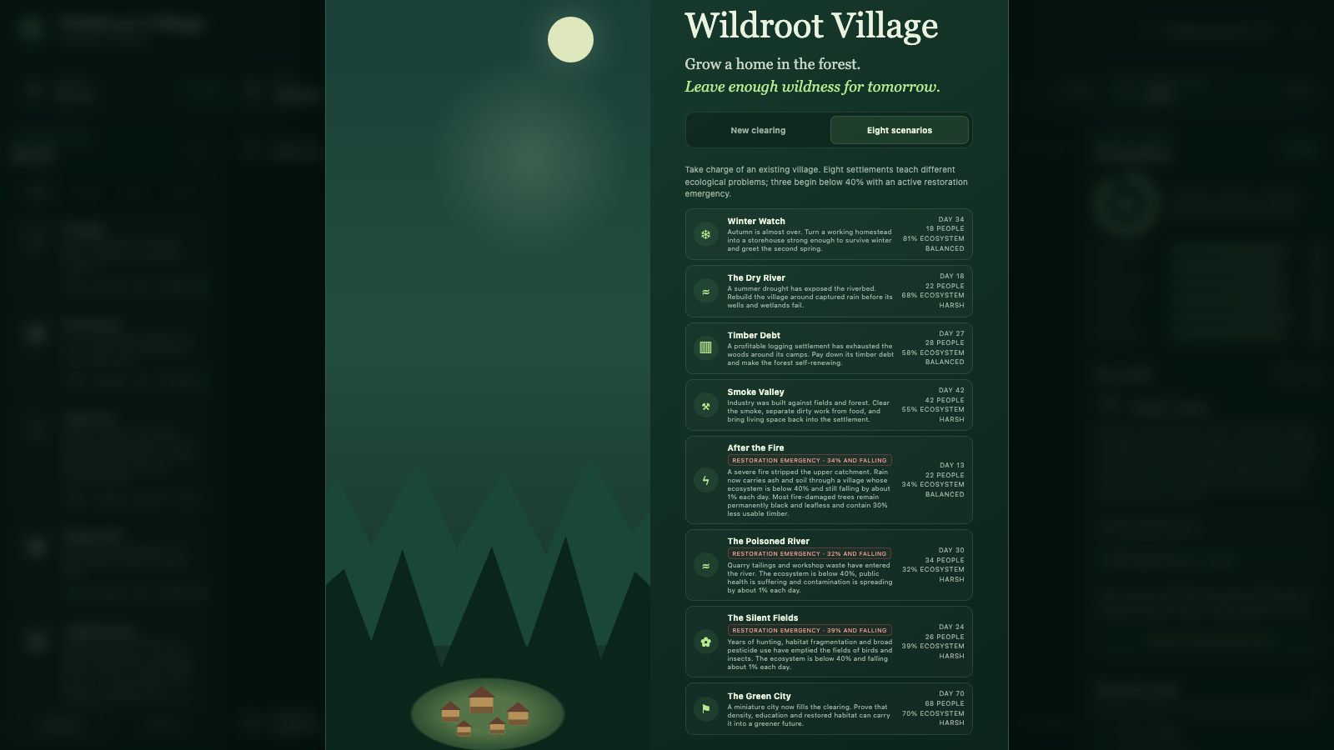
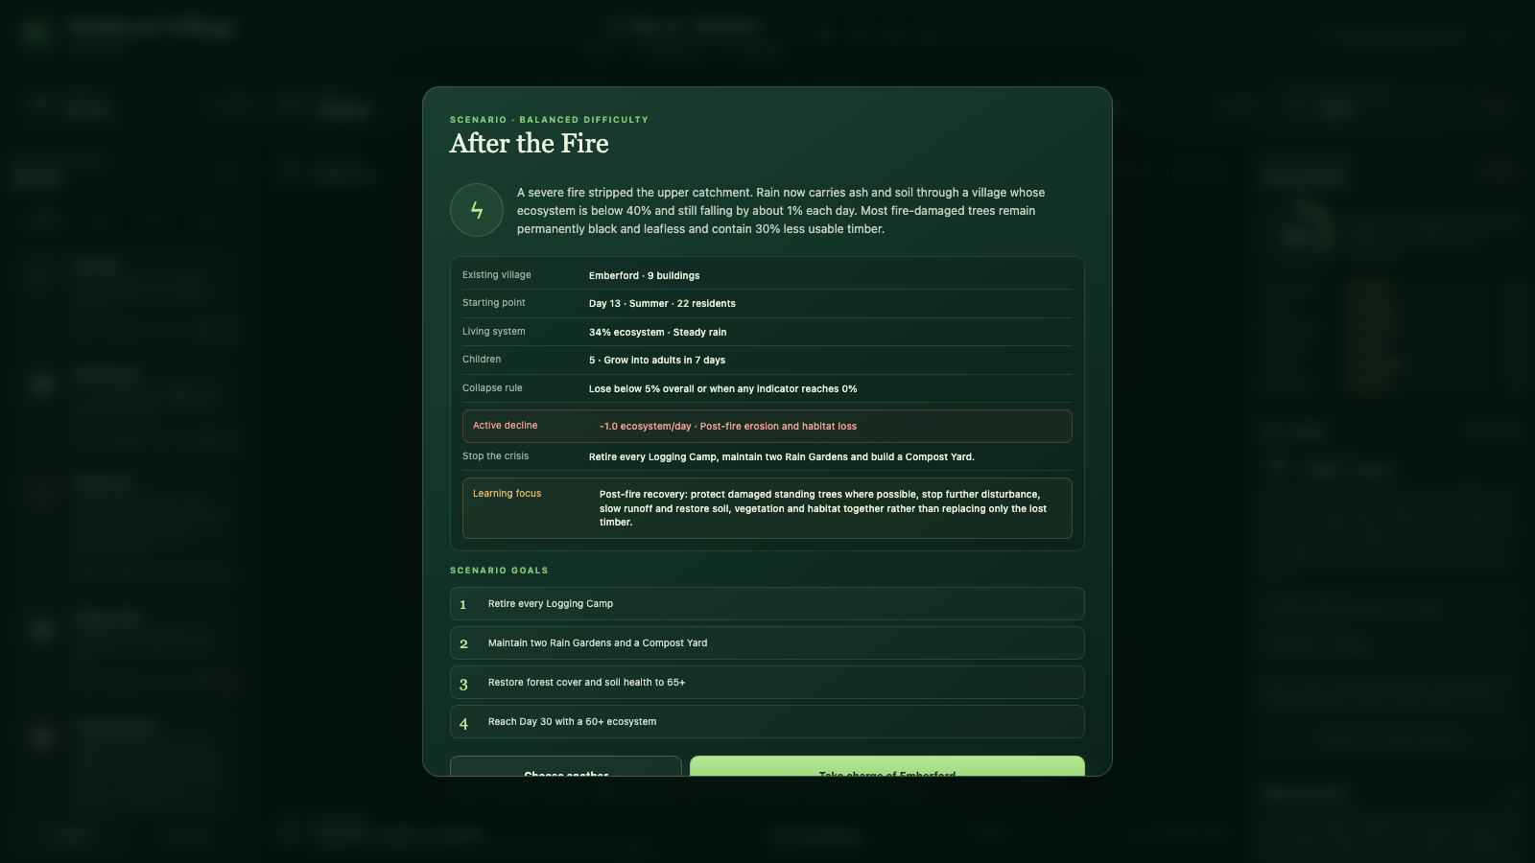
SCENARIOS, WEATHER AND RISK
07
Eight scenarios turn systems into problems
Each village begins with a different crisis, four measurable goals and a named environmental learning focus.
8 STARTING VILLAGES
RESTORATION BRIEFING
FIVE CHALLENGE VILLAGES
THREE ACTIVE EMERGENCIES
DYNAMIC RISK
Winter Watch · The Dry River · Timber Debt · Smoke Valley · The Green City They test seasonal reserves, drought, renewable forestry, clean industry and dense sustainable growth.
After the Fire · The Poisoned River · The Silent Fields Each starts below 40% and loses 1.0 ecosystem point/day until its containment actions are completed.
Weather ranges from ~2-hour thunderstorms and ~12-hour rain to 3-day heatwaves, 4-day cloud systems and 7-day droughts. Random events arrive every ⅓–7 days.
WILDROOT VILLAGE · ECOSYSTEM VILLAGE PROJECT
7

Slide 8
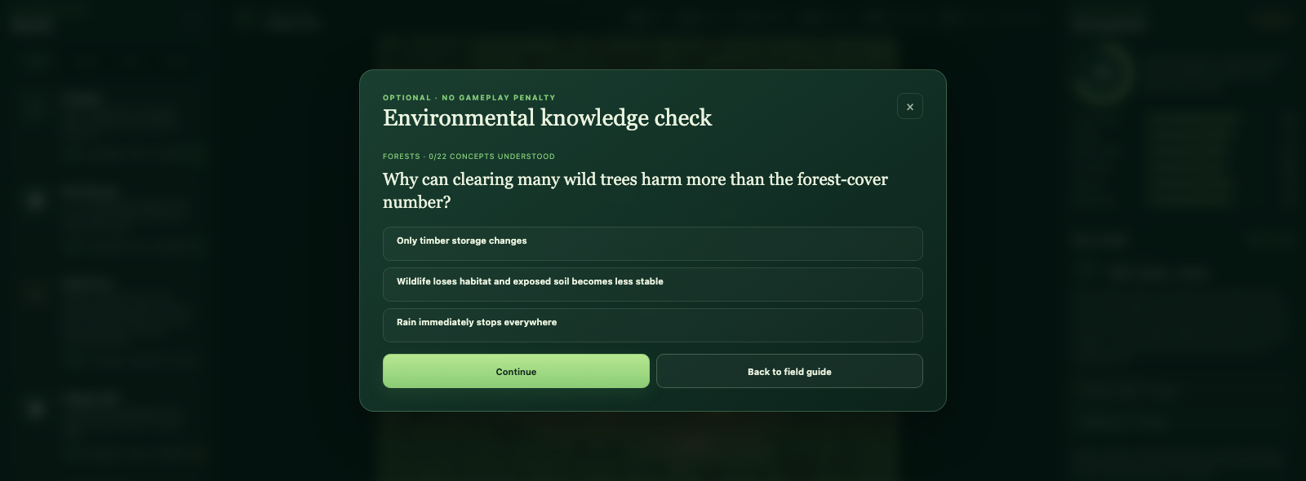
LEARNING, PROGRESSION AND SUCCESS
08
Learning is built into the decisions
Players learn by observing consequences, testing ideas and explaining what the model leaves out.
THE LEARNING LAYER
1
20 field missions — demonstrate principles through normal gameplay; every lesson links to a real-world example.
2
22 knowledge checks — pause time, explain correct and incorrect answers, and give no resource reward or penalty.
3
Learning everywhere — Eco Coach advice, building inspections, events and scenario briefings all include a learning lens.
4
Model literacy — the game names its simplifications and points to field evidence, local and Indigenous knowledge and uncertainty.
FIELD MISSIONS
5
Saved progression — learning and achievements persist locally with the current village.
BUILD → MEASURE → ADAPT → LEAVE WILDNESS FOR TOMORROW
FINAL CHAPTER
Day 100 · nature buildings · every indicator 90+ · 100% ecosystem
NO GAMEPLAY PENALTY
WILDROOT VILLAGE · BUILD A RESILIENT FUTURE
8

